Slide 1
Store Sales Forecasting
Corporacion Favorita demand forecast portfolio project
28,512
validation rows
16 days
forecast horizon
Goal: forecast 16 days of daily sales at date, store and family grain.
Recommended model: LightGBM global forecasting model.
Serving surface: FastAPI batch prediction endpoint with Docker config.
28,512
future rows
12,338,063
future total sales

Slide 2
Business Problem
Short-term replenishment support
Forecast expected sales for each store and product family.
Reduce risk of stockouts, excess stock and poor holiday or promotion planning.
Use known future context: calendar, store metadata, promotions, holidays and oil features.
Keep the model interpretable enough for business review and portfolio storytelling.

Slide 3
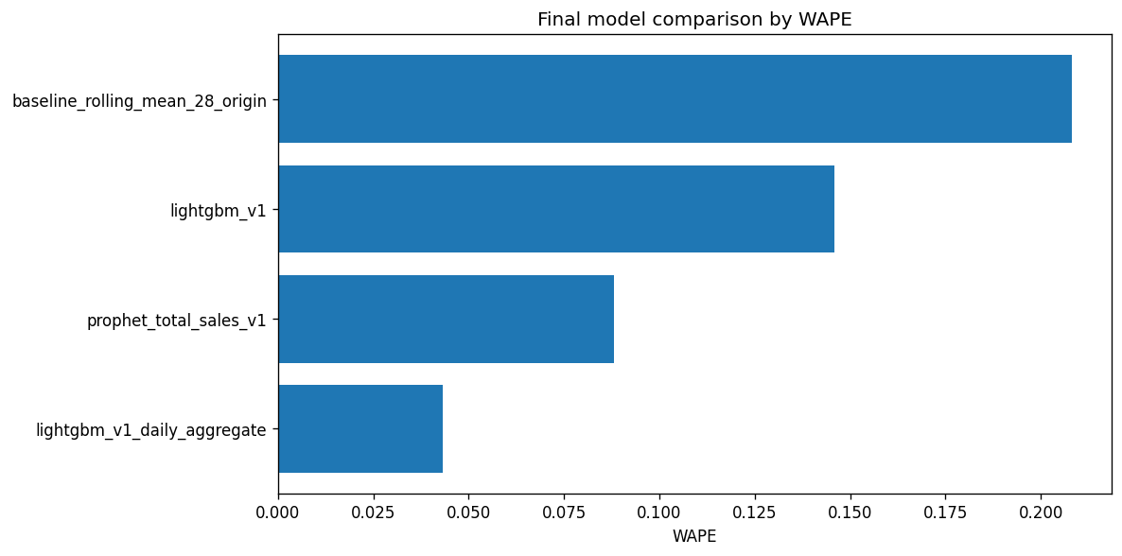
Model Selection
LightGBM outperformed the operational baseline
0.4167
LightGBM RMSLE
0.5216
Baseline RMSLE
14.6%
LightGBM WAPE
20.8%
Baseline WAPE

Slide 4
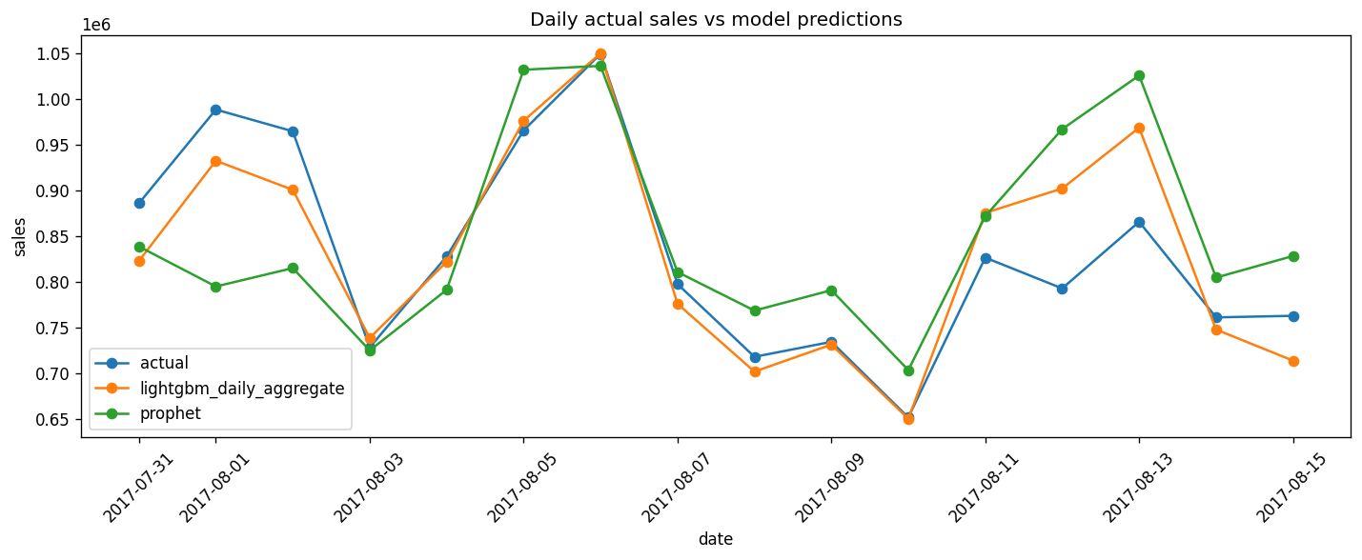
Daily Forecast Quality
Aggregate trend check
Validation window: 2017-07-31 to 2017-08-15.
Daily aggregate LightGBM RMSLE: 0.0574.
Daily aggregate Prophet RMSLE: 0.1070.
Total forecast bias: -0.08%.

Slide 5
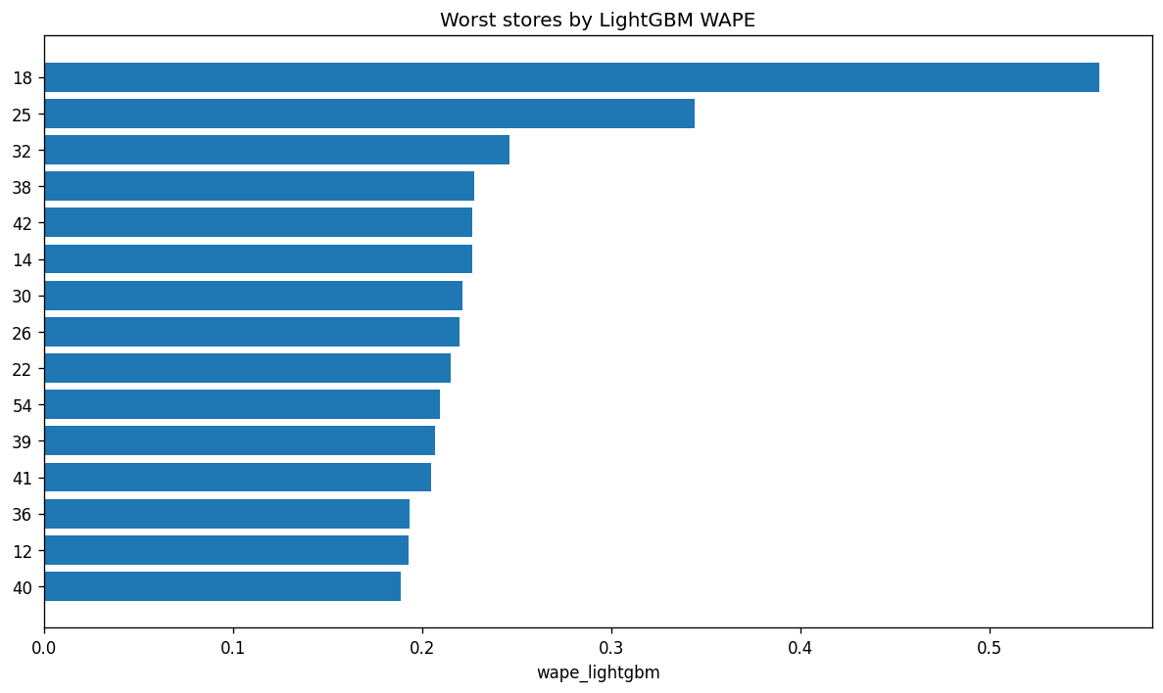
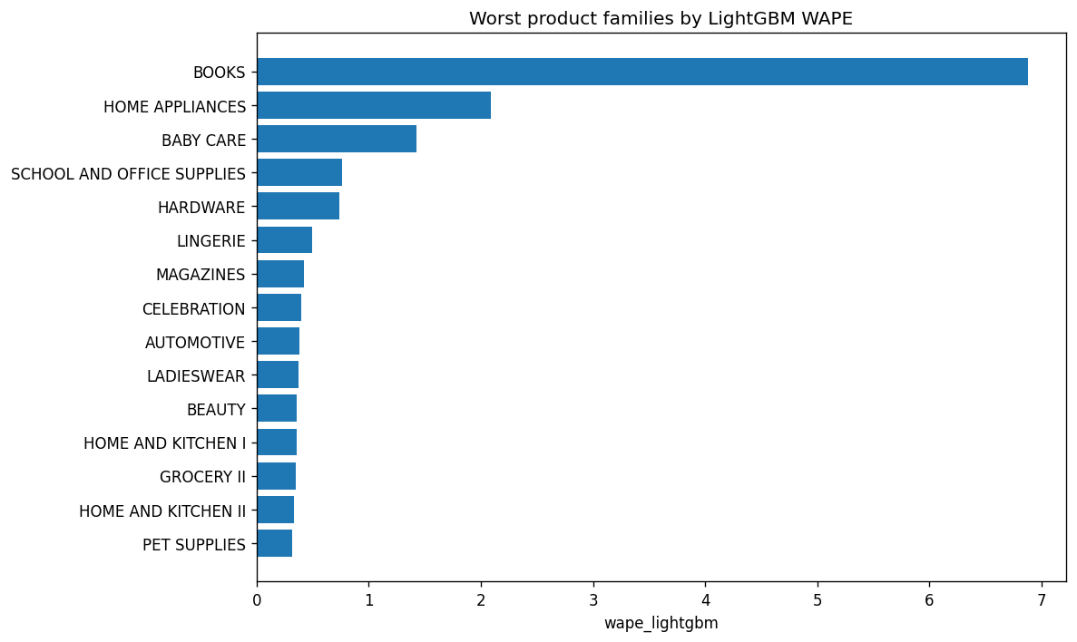
Operational Risk Views
Where planners should monitor forecast error

Slide 6
Serving And MLOps Readiness
API-ready model artifacts
FastAPI exposes liveness, readiness, feature contract, model metadata and batch predict endpoints.
Dockerfile copies only the API, source modules, model files and required serving features.
New tests validate artifact availability, model contract compatibility, API endpoints and input errors.
CI now installs production/dev dependencies, compiles source, runs tests and builds the Docker image.

Slide 7
Next Iteration
Practical improvements after portfolio handoff
Build the Power BI report from the generated dashboard/data_exports CSV layer.
Add automated feature generation for raw date, store and family requests if serving non-technical users.
Register the final LightGBM artifact in MLflow and add deployment promotion gates.
Monitor high-risk stores, families, holidays and promotion periods after launch.

